Slide 1
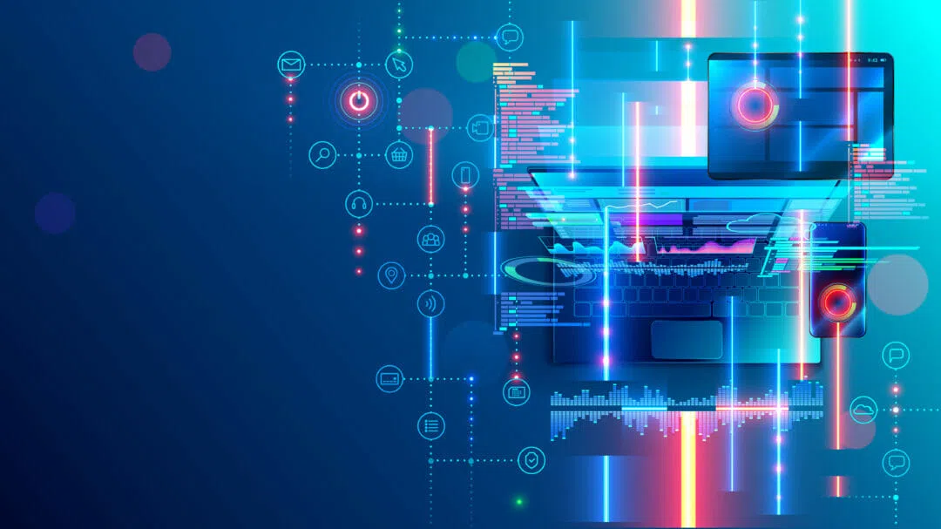

IoT Course
Marc Dujardin
2025

Slide 2




t
t
INTERNET OF THINGS
t
Let’s take 5 minutes to know each other
Marc Dujardin
I am a telecommunications engineer from Telecom Paristech and a 2017 graduate of the IESE MBA program.
I have over seven years of experience in IT and management consulting, primarily in the telecommunications and financial services sectors. Additionally, I spent more than eight years at CaixaBank as a product owner, focusing on digitalization and artificial intelligence.
My career has taken me across a wide range of fields, from IT consulting to business strategy. I’ve also lived and worked in various countries, including France, the UK, Switzerland, Venezuela, Brazil, Spain, and India. I’m currently based in Barcelona.
I am passionate about digitalization, data science, and AI, and their potential to transform society and businesses. However, I find it frustrating how marketing can often distort or oversell what technology really does and what it’s capable of.
In my free time, I enjoy hiking, philosophy, cooking, music, and exploring the wonders of science.
+34 722 26 36 35
mdujardi@gmail.com

Slide 3

t
t
INTERNET OF THINGS
t
1
Introduction : Considerations for the course
Objective of the course:
Data is in the center of everything we do. Managing It the right way is crucial for companies in order to functional efficiently and generate business opportunities. I this course you will learn the basic concepts of Data governance so you can be Data Savvy in your next jobs. Managers who understands Data governance will have a clear advantage on others.
Requirement for this course:
"Data Horror Stories" Research Task: Have students research and summarize a real-world case where poor data governance led to business losses, legal issues, or operational failures. Come up with a set of actions that would have prevent the company to get into trouble.🔍 Deliverable: A 5-minute presentation.
Course plan
Evaluation > 50% participation / 50% project
Session 1 : 4/04 – 4h
Session 2 : 11/04 – 4h
Introduction IoT
Practicce
IoT applications
Project presentation
Any questions before we start?

Slide 4
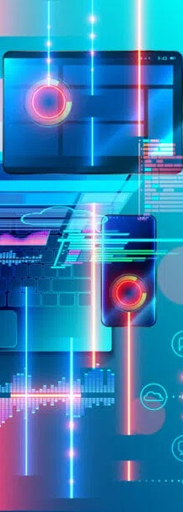

Agenda
Introduction to IoT
IoT applications
IoT value chain / market
Let’s play – Design a home project
What limits/strengthen the development of IoT
Final exercise
1
2
3
4
5
6

Slide 5
t
t
INTERNET OF THINGS
t
1
Introduction to IoT : What is IoT?
A few definitions of IoT
The Internet of things (IoT) describes physical objects (or groups of such objects) with sensors, processing ability, software and other technologies that connect and exchange data with other devices and systems over the Internet or other communications networks – Wikipedia
The Internet of Things (IoT) is the network of physical objects that contain embedded technology to communicate and sense or interact with their internal states or the external environment. – Gartner
In a nutshell, the Internet of Things is the concept of connecting any device to the Internet and to other connected devices. The IoT is a giant network of connected things and people – all of which collect and share data about the way they are used and about the environment around them. – IBM
The term IoT, or Internet of Things, refers to the collective network of connected devices and the technology that facilitates communication between devices and the cloud, as well as between the devices themselves.- Amazon
Some synonyms of IoT : Connected object / Smart object …
Connected
Objects
Exchange data
Processing
Sensors
Software
Internet
Communication network
Cloud
Devices
Interact
Notes:
I don´t know about you but I am strugguling to find a comon definition in tech nowadays, AI, IoT, Cripto, NFT, etc.
IoT does it have to be connected to the internet

Slide 6
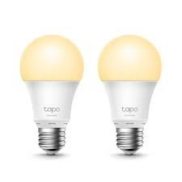



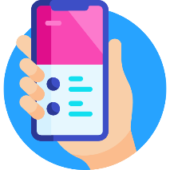
t
t
INTERNET OF THINGS
t
1
Introduction to IoT : Before we start do you how to configure an IoT light bulb?
The lightbulb emits a Wifi signal whenever it’s not configured
Use your phone and the right APP to connect to the light bulb via Wifi direct
Connect the lightbulb using wifi direct and send it the wifi password. The device will restart and connect to the internet using the wifi password you just gave him.
Now control it from your phone inside or outside your house
How can you phone connects to the light bulb?
You APP know the ID/password of the light bulb
The lightbulb connect to a IoT cloud platform using the same ID
Whenever you send an order, your phone send an order to the IoT cloud platform indicating the ID of the lightbulb it want to act on. The cloud platforms that is already connected to many IoT devices look for the device with this specific ID and send the order
Notifications can also be sent to your phone from the lightbulb passing through the cloud
Connected, Waiting for orders
Switch on, off, dim light, programmation
The first one to connect to the light bulb earns one point
Smart Light bulb with an ID
Basic configuration
Wifi, Password
Smart phone with manufacturer APP
Notes:
Most of Iot object Works like that
Some APP scan be used with multi manufaturers

Slide 7
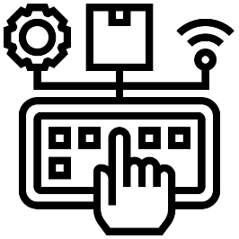
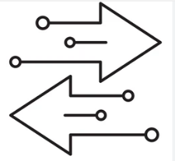


t
t
INTERNET OF THINGS
t
1
Introduction to IoT : Why would I connect a lightbulb to the internet?
Enhanced control
Ubiquitous – can access to the light bulb outside of your house
Using AI assistants – Voice / Natural language control
Configuration for devices that don’t have an interface (Intensity , Colors , Modes, etc.)
2 ways communication / information collection
Know when the light bulb is switch on/off
Know when the light bulb is disconnected
Intelligence
Scheduling / Mode disco / holidays / etc.
Coordination between lightbulbs / other devices (ex : blinds)
Access internet information
Energy saving
Automatically switch off the light after a certain time
Switch off the light if nobody is home
And it’s just a lightbulb….
Notes:
Inteligence – it’s why they are called smart

Slide 8
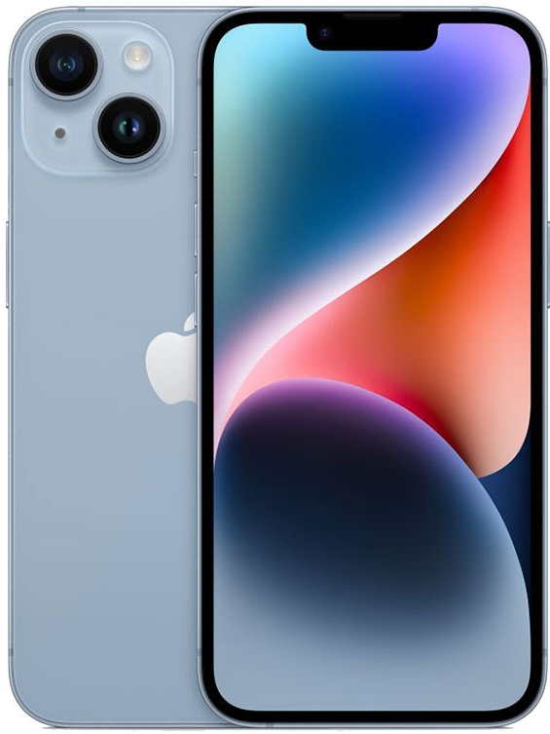
t
t
INTERNET OF THINGS
t
1
Introduction to IoT : What is the IoT device we all own?
Battery
Sensors
Camera
Microphone
Touch Screen
GPS
Compass
Barometer
Three axis gyroscope
Accelerometer
Proximity sensor
Ambient light sensor
Connectivity
Phone Network – 2G/3G/4G/5G
Wifi
Bluetooth
NFC
Processing/Storage
Processor
Memory RAM / ROM
SD
Graphics (GPU)
Many devices at once:
Phone
Tracking GPS system
Health device – how many steps, quality of sleep – connected to smart watch
Virtual assistant
Intelligent speaker
E-Reader
Controller for other devices
Actuators
Vibration
Speaker
Flash
Screen
Cloud
Google photo / drive
DropBox
Take 5 minutes to list all the functionalities of your phone

Slide 9
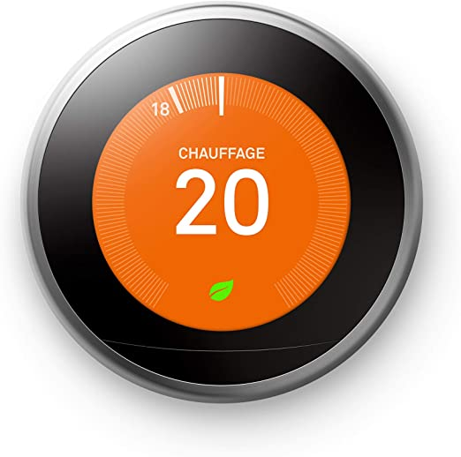
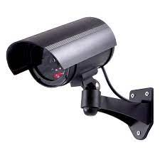
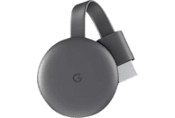
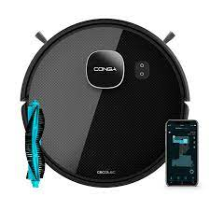
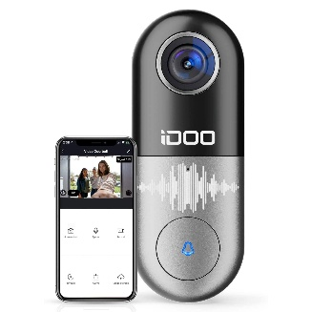

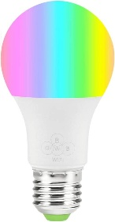
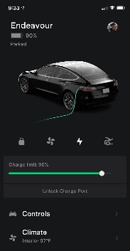

t
t
INTERNET OF THINGS
1
Introduction to IoT : How many IoT applications do you have on your phone?
Home Camera
Smart Termostat
Smart TV / TV dongle
Solar Panel
Smart hover - Conga
Smart Doorbell
Smart Health
Smart light
Smart Car
IoT Is already everywhere
Notes:
Surpise me
Smart watch etc.?
The silent revolution – iot is everywhere and did we even realise

Slide 10


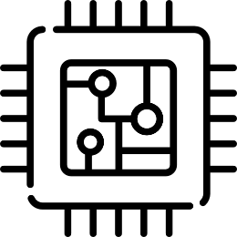
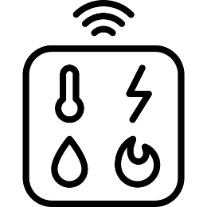




t
t
INTERNET OF THINGS
t
1
Introduction to IoT : What do you need to make an IoT system? (1/4)
An IoT system generally is composed of the following elements:
Connectivity
4G/5G
Wifi
Lora
Sigfox
ISP - Telco
Memory / RAM / ROM
SSD
SD Card
SRAM
Processor CPU / GPU
ARM
Risk
X86
Sensors
Temperature
Camera
Humidity
Movement
Cloud platform for extra capabilities
Azure/AWS IoT
Cayenne
User Interface to visualize the Data and control the device
OS: Linux, windows, etc.
Google assistant
Alexia
Actuators
Servos
Relays
Speaker
Light
Energy to power
the device
Battery
AC / DC
Notes:
Conectivty : Range / Broadband /energy consumption / Latency / One way / 2 ways / Com device and telco
Memory : Speed / Permanent or temporary (erased every time power does off) – to store the OS, the data
Processor / GPU : Calcultation power / Consumption – IoT systems tend to be limited in calculation and this can be done in the cloud but be careful because if the connection fails? Need some automous system.
Sensors : How many sensors / How often should I measure?
Cloud platform for extra capabilities: extra calculation power, extra storage, AI models running
Interface to visualize or control : IoT device doesn t need a screen but data have to be seen somewhere. Important function is to be able to Schedule tasks
Energy : AC/DC / Battery / solar panel / windmill
Actuators : they use energy too /

Slide 11
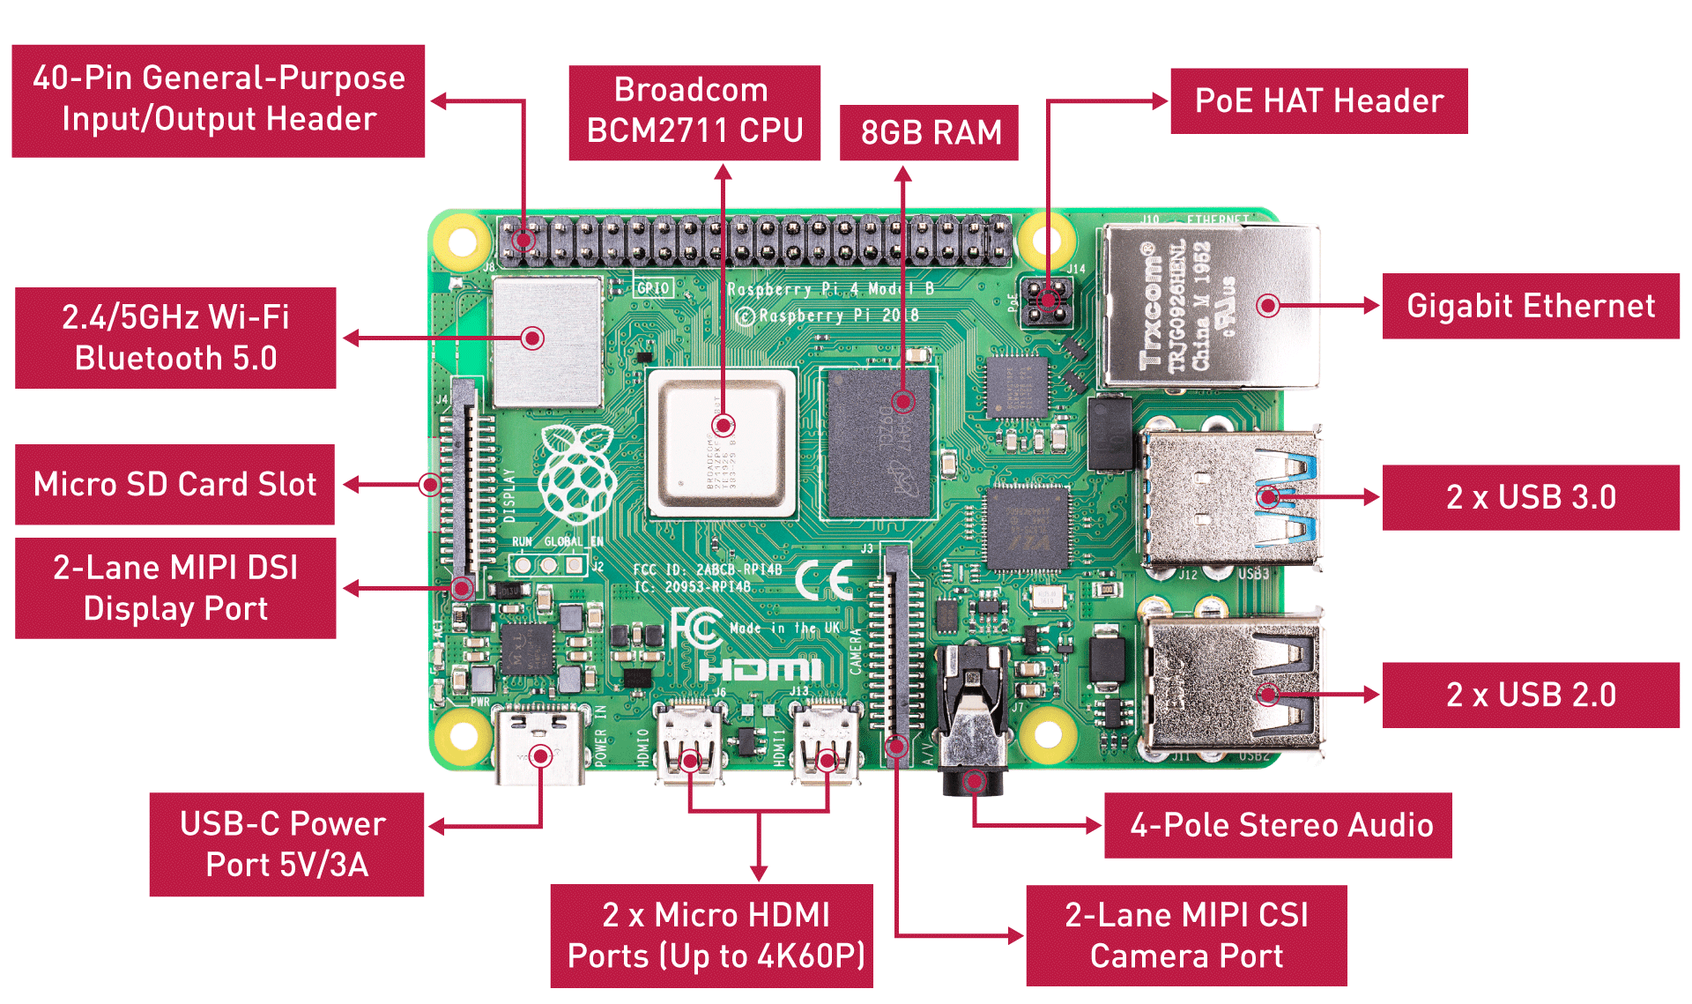

t
t
INTERNET OF THINGS
t
1
Introduction to IoT : What do you need to make an IoT system? (2/4)
To add extra functionalities, 4g, GPS, etc.
Many options:
Raspberry Pi
Arduino
Onion Omega2+
ASUS Tinker Board S
ClockworkPi
Rock64 Media Board
Banana Pi
Orange Pi
NanoPi NEO2
Small single-board computers (SBCs) comes in all sizes, all budget – From 2 euros to ….

Slide 12
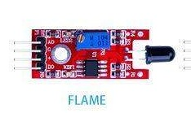
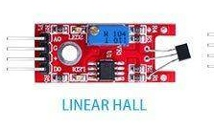
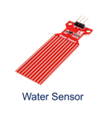
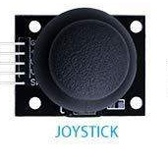
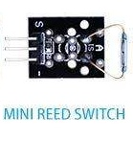
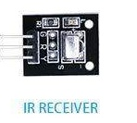
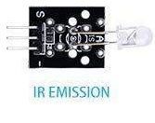
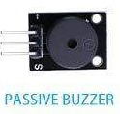
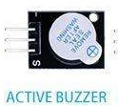
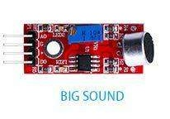
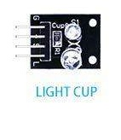
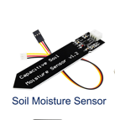
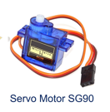
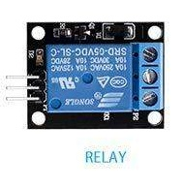
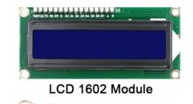
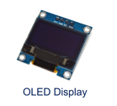
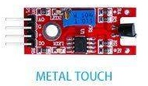
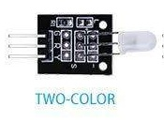
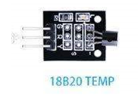
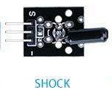

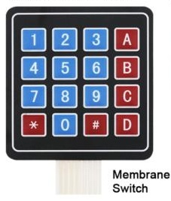
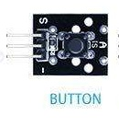
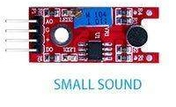
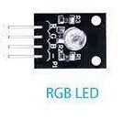
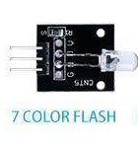
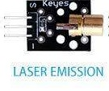
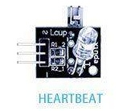
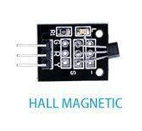
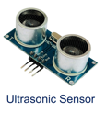
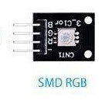
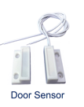
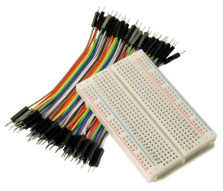


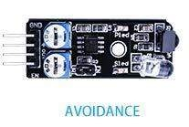


t
t
INTERNET OF THINGS
1
Introduction to IoT : What do you need to make an IoT system? (3/4)
Control / Display
Sensors
Actuators
Conectivity
Jumper wires
+ Board
Bluetooth
Wifi
A few examples of controls, sensors, actuators, etc. Do you know what they do?
Notes:
Flame : Detect infrared
Hearbeat : Phototransistor and a led to detect pulse through the skin
Light cup : Has a mercury sensor to detect incluniation and switch on the light
Two colors : Red and Greeen

Slide 13








t
t
INTERNET OF THINGS
1
Introduction to IoT : What do you need to make an IoT system? (4/4)
How to program your IoT system?
Control / Display
Connectivity
Iot Device
Connectivity – Home Wi-Fi or Cable
Communication protocols : SSH command base, VNC virtual desktop
Setup through SD or USB cable
A Let’s connect to my Raspberry Pi
Notes:
Flame : Detect infrared
Hearbeat : Phototransistor and a led to detect pulse through the skin
Light cup : Has a mercury sensor to detect incluniation and switch on the light

Slide 14







t
t
INTERNET OF THINGS
1
Introduction to IoT : A little project mixing IoT and Gen AI
An AI Agent accessed by Telegram that can activate up to 8 different power switch
Notes:
Flame : Detect infrared
Hearbeat : Phototransistor and a led to detect pulse through the skin
Light cup : Has a mercury sensor to detect incluniation and switch on the light

Slide 15
Agenda
Introduction to IoT
IoT applications
IoT value chain / market
Let’s play – Design a home project
What limits/strengthen the development of IoT
Final exercise
1
2
3
4
5
6

Slide 16








t
t
INTERNET OF THINGS
t
2
IoT applications: How many IoT markets do you know?
Smart Health / Wearable
Smart Logistics
Smart Farming
Smart City
Smart Budlings / Home
Industrial Internet of Things (iIoT) /Industry 4.0
Smart Grid
Smart Retail
In 10 minutes in groups, find as many IoT systems as possible in these markets?
Notes:
This is one segmentation of the market / you have many more

Slide 17



t
t
INTERNET OF THINGS
t
2
IoT applications: Can you give me IoT solutions used in each of these markets?
Traffic light management
Smart Parking
Pollution management
Video Surveillance
Water meters
Electricity production
Smart Buildings – light / temperature
Fire Management
Electric meters
Intelligent grid system
Solar panel inverter
BS ( Battery Management System)
Smart City
Smart Grid
A
Smart health phone
Smart watch
Smart ring
Smart health tablets
Audition device
Drones to kill bad weeds
Robots to harvest
Smart watering
Autonomous tractor
Grain silo monitoring
Livestock monitoring
Smart Health / Wearable
Smart Farming
Notes:
This is one segmentation of the market / you have many more

Slide 18
t
t
INTERNET OF THINGS
t
2
IoT applications: Can you give me IoT solutions used in each of these markets?
Optimzed Energy consumption
Smart security
Automatized cleaning
Smart warehousing
Predictive maintenance
Route optimization
Fleat monitorization
Drone deliveries
Smart Logistics
Smart Budlings/ Home
Smart shelves
Smart mirrors
Personalized marketing
Predictive maintenance
quality control
Supply chain optimization
Advanced product tracking
3d printing
Industrial Internet of Things (iIoT) /Industry 4.0
Smart Retail
Notes:
This is one segmentation of the market / you have many more

Slide 19



t
t
INTERNET OF THINGS
t
5
What limits/strengthen the development of IoT: How can AI power up IoT?
Virtual assistants
Edg AI – Autonomous Robots
Data Analysis
Virtual Assistants to control IoT device – Lights, Car, Speakers/ Music, electric plugs, thermostat, TV, etc. – The language model is in the could, not in the smart speaker. Without connection it doesn’t work.
Edge AI is a system that uses Machine Learning algorithms to process data generated by a hardware device locally. The device does not need to be connected to the internet to make decisions in real time. Models are trained on platforms and deployed locally.
Look at Tiny ML for AI on even small IoT devices
IoT devices generate vast amounts of data, but raw data doesn't bring value. You can use AI to extract a lot of value from all this data. Example of applications are predictive maintenance, process optimization, etc.
Example cars tesla autopilot

Slide 20

t
t
INTERNET OF THINGS
t
2
IoT applications: What is industry 4.0 and what are its characteristics?
This Fourth Industrial Revolution is, however, fundamentally different. It is characterized by a range of new technologies that are fusing the physical, digital and biological worlds, impacting all disciplines, economies and industries, and even challenging ideas about what it means to be human. – Klaus Schwab author of the book “The Fourth Industrial Revolution”
New paradigm
AI Design
Shorter time to market
Better design
3D printing
Building parts that were not possible to build before
More customization
Less stock (Cost saving)
More intelligent robots
Computer vision
Predictive maintenance
Interconnectivity
Edge computing/AI Cloud
Constant improvements
Real time data
What is Industrial Revolution 4.0? https://www.youtube.com/watch?v=whuH4Df85qc
Notes:
This is one segmentation of the market / you have many more
IoT sensors, Network, AI, Big Data, Robots, Macjine vision

Slide 21
Agenda
Introduction to IoT
IoT applications
IoT value chain / market
Let’s play – Design a home project
What limits/strengthen the development of IoT
Final exercise
1
2
3
4
5
6

Slide 22












t
t
INTERNET OF THINGS
t
3
IoT value chain / market: How to structure the IoT market?
Using the value chain is generally a good approach to understand a market and position the key payers. To do so, we have breakdown the price in its different constituents. Nowadays nobody controls its almost impossible to control the whole value chain
Hardware 30%
Connectivity 10%
Software 60%
Smart Device
Connectivity
IoT Platform
Services
Customer
The device including design, processor, memory, actuators, sensors, network device,
OS software
Connectivity provided by a telecommunication operator though fiber, 4/5G, Loran, etc.
Cloud Platform generally used to collect the data, display them and control the device. This platform can be accessed using a browser or an APP
Additional services that can be added like maintenance, consulting, integration, implementation
Marketing, Sales, resellers
Notes:
I made because I couldnt find one that would satisfy me fully
Sales/Marketing/Intermediary can intervene each time one more than one company is imovlved

Slide 23
Agenda
Introduction to IoT
IoT applications
IoT value chain / market
Let’s play – Design a home project
What limits/strengthen the development of IoT
Final exercise
1
2
3
4
5
6

Slide 24


t
t
INTERNET OF THINGS
t
4
Let’s play – Design a home project: How to become more knowledgeable on IoT? (1/3)
Build a project is a best way? I’ll give you an example of a simple IoT project I build
The revolution of home IoT projects thanks to Small single-board computers (SBCs)
Smart Gardening ☺
Objective:
Create a system that can:
Water plants and trees
Activate and disactivate the electric fence
Take a picture/video each time an animal is detected
Trigger an alarm each time an animal is detected
The system is in the middle of the forest, no electricity and no fiber/ADSL connection
Actions can be scheduled / or controlled manually though a web interface
Skills required:
Basic network knowledge
Basic electronic
Basic programming
Expert in search in forum
Patience – step by step
In 15 minutes in groups, think of how you would design this system? Think of new functionalities that would add value?

Slide 25



t
t
INTERNET OF THINGS
t
4
Let’s play – Design a home project: How to become more knowledgeable on IoT? (2/3)
4 things to consider when you design an IoT system
Energy – How will the system be powered? What should be the capacity of my battery? What is the voltage of the different components of the system, etc.
Computing – Where will the data processing be performed? Can I use AI models on my SBC or do I need to take it to the cloud ? AI requires a lot of computing power – Training a lot more than inference
Storage – Where will the information be stored (Photos for example) – How should I manage the back up of my system?
Connectivity – How to overcome network problems? VPN, NAT, etc. What type of connection should I use? Wi-Fi/4g/Bluetooth, Range? Will I have enough bandwidth? Do I need low latency?

Slide 26




















t
t
INTERNET OF THINGS
t
4
Let’s play – Design a home project: How to become more knowledgeable on IoT? (3/3)
Any idea to improve the system?
Power source
SBCs
Connectivity
Controller
Actuators
Personal Smartphone
Electric Fence
Raspberry Pi
VPN
Solar Panel
100W
Storage / OS
4G dongle +
SIM Card
Cloud Camera
platform
Relay
On/Off
Solenoid valve
Sensors
Solar Charge Controller
Water pump x2
Wifi Camera with motion detection x2
Solar Wifi
Movement sensor
& alarm
Control Webpage / Chatbot on Telegram
Car Battery
Notes:
4 things to take into acount when you design a system
- energy – how the devices will be powered, what is the voltaje, will I have enough power,etc.
-connecity – how will the device be controled / contected – VPN, Wifi/4g, Range, etc.
. Computing : Where will the
- Storage – where will the information be stoerd – for example pictures

Slide 27
Agenda
Introduction to IoT
IoT applications
IoT value chain / market
Let’s play – Design a home project
What limits/strengthen the development of IoT
Final exercise
1
2
3
4
5
6

Slide 28
t
t
INTERNET OF THINGS
t
5
What limits/strengthen the development of IoT: When IoT goes too far ☺
Smart Toilet Paper Holder : The IOToilet is the first smart toilet paper holder, that keeps track of our daily usage of toilet paper and allows accumulating stats showing these metrics. And why should I care about my daily usage of toilet paper you may ask? Well, as it turns out, our abdominal health, especially the digestion cycle, has a lot to do with both our physical health and our mental one. https://www.instructables.com/IOToilet/
Other examples:
Smart fork, because great food should be measured in "fork servings.“
Smart egg tray, so you know how many eggs are left, without opening the fridge door.
Smart frying pan, so your smart egg tray and fork have someone else to talk to. Smart toothbrush, because we all remember lying to mom about brushing our teeth.
https://www.qorvo.com/design-hub/blog/the-bottom-10-iot-gifts

Slide 29

t
t
INTERNET OF THINGS
t
5
What limits/strengthen the development of IoT: What is undermining the IoT development? (1/2)
Let’s take an example to understand it’s limitation - What is a SmartHome composed of?
Home appliances : Smart hover, Smart Washing Machine, Smart Fridge, Smart Dish Washer
Smart environment : Smart thermostat, Smart heat pump, Smart lights, Smart Blinds
Smart Security: Smart Doorbell, Smart lock, Smart camera, Smart Alarm
Smart Energy: Solar panel, Smart Battery
Smart transportation: Electric Car
Are my devices compatible with one another?
How could I coordinate my different IoT systems?
How could I control everything from one place? (Open source / Proprietary platforms)
How to I ensure the security of my house? If a hacker hacks my smartlock?
Am I willing to pay extra for every device I buy?
How can I control a device that is not smart?
Should I make my own system or buy one?

Slide 30






t
t
INTERNET OF THINGS
t
5
What limits/strengthen the development of IoT: What is undermining the IoT development? (2/2)
Interoperability and Standards- Remember Blue rays versus DVDs ? – Processors : Risk / ARM /X86 processor –Communication protocols - Zigbee / z-wave / Lora / LowPAN / NFC / Bluetooth / Wifi – Etc.
Battery capacity and life are not improving at a very high rate. Improvements are more due to lower energy consumption of processor (soon 2nanometers)
Processor/ GPU / Memory to execute AI – AI models require a lot of computing power to be trained and executed (Inference). Computing power can be transferred to the cloud / What happens when the connection fails? Or is slow?
Security – So many new devices to attack and control. Imagine if someone take control of your car, door, camera, etc.
Regulatory and Legal Issues:– IoT devices often collect, transmit, and store vast amounts of data, some of which can be highly personal or sensitive.
Cost of the hardware : Price of the hardware went up during the pandemic. It is still very difficult to find de raspberry pi

Slide 31
Agenda
Introduction to IoT
IoT applications
IoT value chain / market
Let’s play – Design a home project
What limits/strengthen the development of IoT
Team project
1
2
3
4
5
6

Slide 32




t
t
INTERNET OF THINGS
t
6
Final exercise : Innovation challenge
How can IoT help fight global warming?
Invent one IoT system that would help to fight climate change and describe how it will work.
Draw a quick schema of the system?
What kind of sensors, actuators, hardware would it have?
How the device would be connected /controlled?
How would the device be powered?
What kind of data the system would produce and how would the data be analyzed?
How much would it cost?
Example: Precision agriculture, Balloon to monitor greenhouse gases, smart water meters, etc.
In 30 minutes in groups, design a system to help fight global warming

